Slide 1

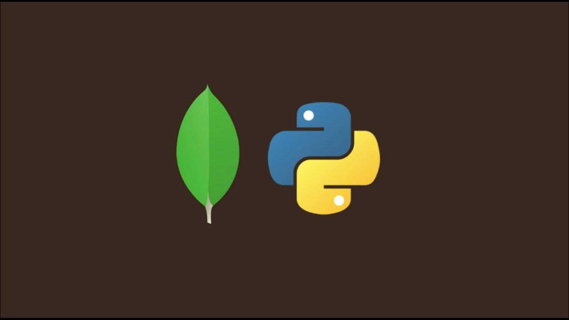
Edunext
Describe how to connect Python with MongoDB

Slide 2
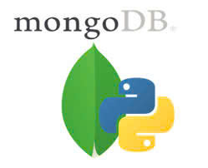
Contents
Hồ Thị Bích Liên
1
Võ Hoàng Khải
2
Trần Thị Thảo
3
Nguyễn Lâm Chí Nguyễn
4
Phạm Hữu Nam Anh
5

Slide 3
There are many ways to connect to MongoDB, and currently our team will introduce 4 connection methods: Pymongo, Motor, Flask, Mongoengine.1

Slide 4
Method 1: To use MongoDB with Python we need to have the "pymongo" library.
How to set up the library: To install with Python.
Use the package manager "pip"1

Slide 5
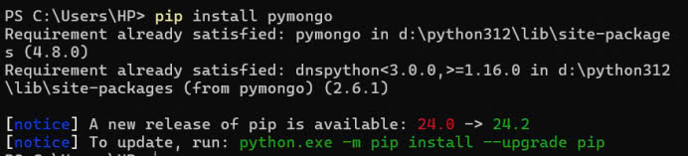
Step 1: Open Terminal or Command Prompt. Depending on your operating system, open Terminal (on macOS or Linux) or Command Prompt (on Windows).
Type the command "pip install pymongo" into Terminal or Command Prompt and press Enter

Slide 6
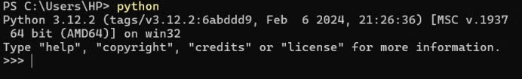
Step 2 : Check if `pymongo` has been installed successfully by opening Command Prompt and typing the command "python"
If no errors appear and the version of "pymongo" is printed, the installation was successful.

Slide 7
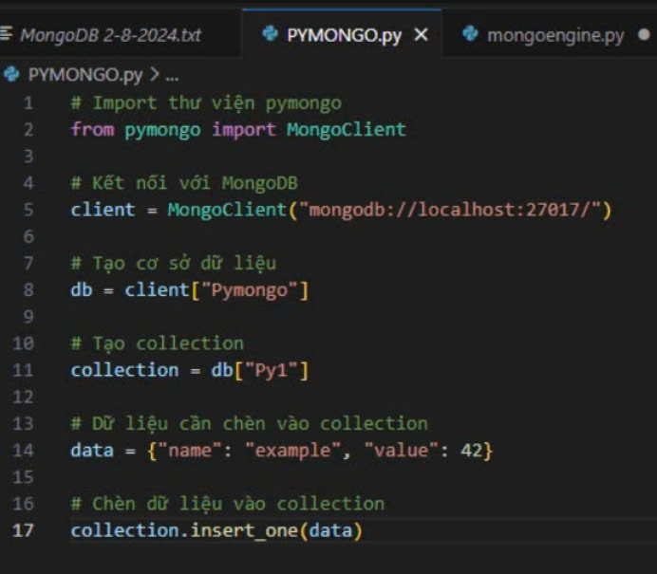
Step 3: Test run connected yet

Slide 8
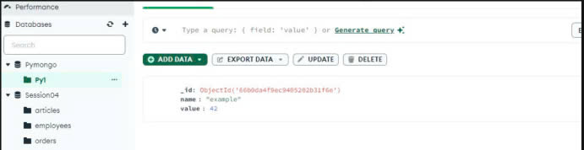
If connected, it will look like this
Open MongoDB compass and we will see the inserted data.

Slide 9
Method 2: Using mongoengine (ORM for MongoDB) : Mongoengine is an Object-Document Mapper (ODM) for MongoDB, which helps you work with MongoDB through Python classes and objects.
Step 1: Open Terminal or Command Prompt. Depending on your operating system, open Terminal (on macOS or Linux) or Command Prompt (on Windows).
Type the command " pip install mongoengine" into Terminal or Command Prompt and press Enter:

Slide 10
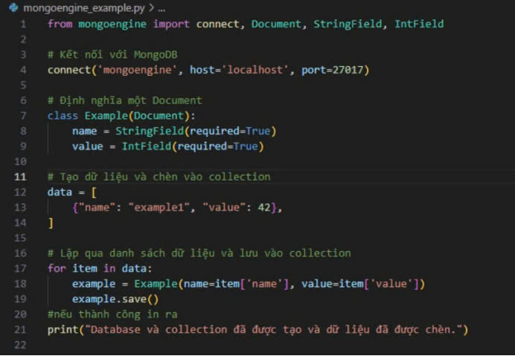
Steps 2 and 3 are in the same order as connecting to Python.
Open visual code to insert data

Slide 11
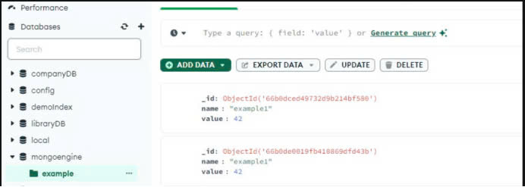
After running
Open mongodb insert data yet

Slide 12
Method 3: Create a connection with the motor. Use motor (Asynchronous Library)
Motor is an asynchronous MongoDB library for Python, suitable when you need to perform asynchronous tasks.
Step 1, 2, 3 are the same as Python but import the command "pip install motor"

Slide 13
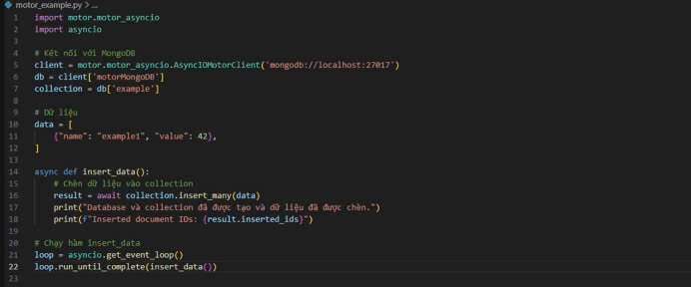
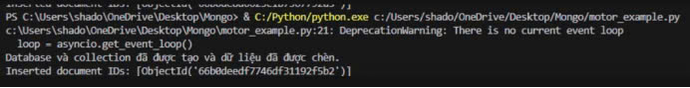
Open visual code to insert data
After running

Slide 14
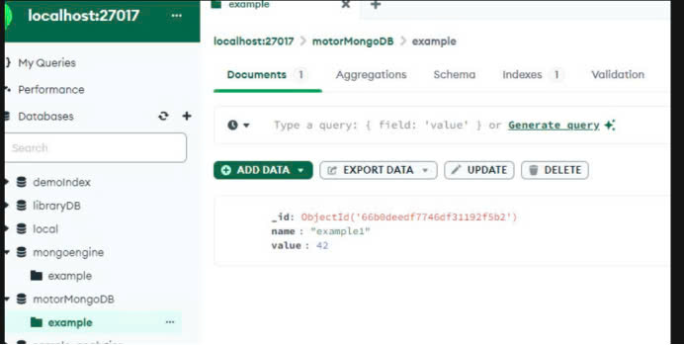
Open mongodb insert data yet

Slide 15
Method 4: Create a connection with Flask
Using flask-pymongo (Integrated with Flask)
This is an extension for Flask that allows you to easily connect to MongoDB from a Flask web application
Step 1, 2, 3 are the same as Python but import the command "pip install flask-pymongo"

Slide 16
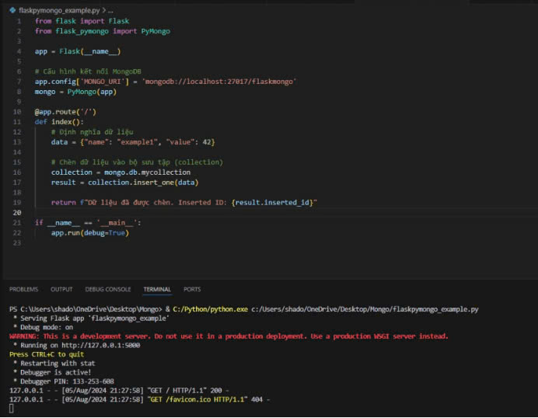
Open visual code to insert data

Slide 17
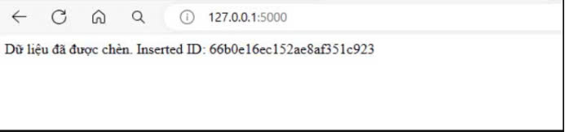
After running

Slide 18
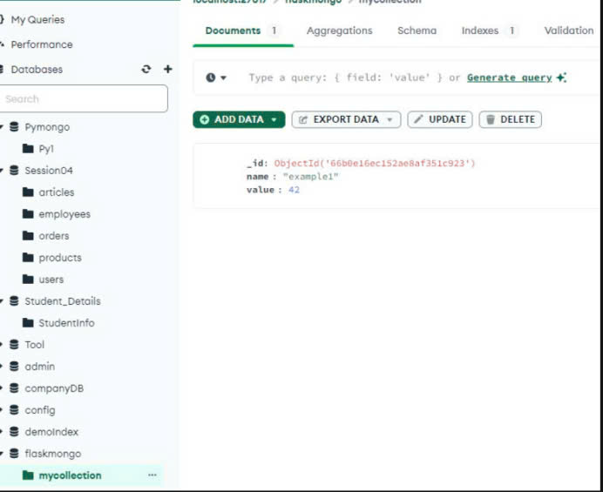
Open MongoDB to see if the data has been inserted.

Slide 19
THANKS
Group 1

